Slide 1




CLOUDFACE ID
A FACE RECOGNITION MODEL

Slide 2


THE TEAM:
2210040069 - Charishma
2210040099 - Apoorva
2210040109 - Jahangeer
2210040072 - Dheeraj
2210040073 - Shivanand

Slide 3

Why use Facial Recognition with AWS?
1️⃣ Prebuilt AI with Amazon Recognition –
Detect, compare, and analyze faces without training your own AI model.
2️⃣ Secure & Scalable –
AWS provides encryption, IAM security, and auto-scaling to handle large volumes of data.
3️⃣ Real-Time & Cost-Effective –
Process live video feeds and images with a pay-as-you-go model, reducing infrastructure costs.
4️⃣ Seamless Cloud Integration –
Works with AWS Lambda, S3, DynamoDB, and API Gateway for building powerful applications.

Slide 4
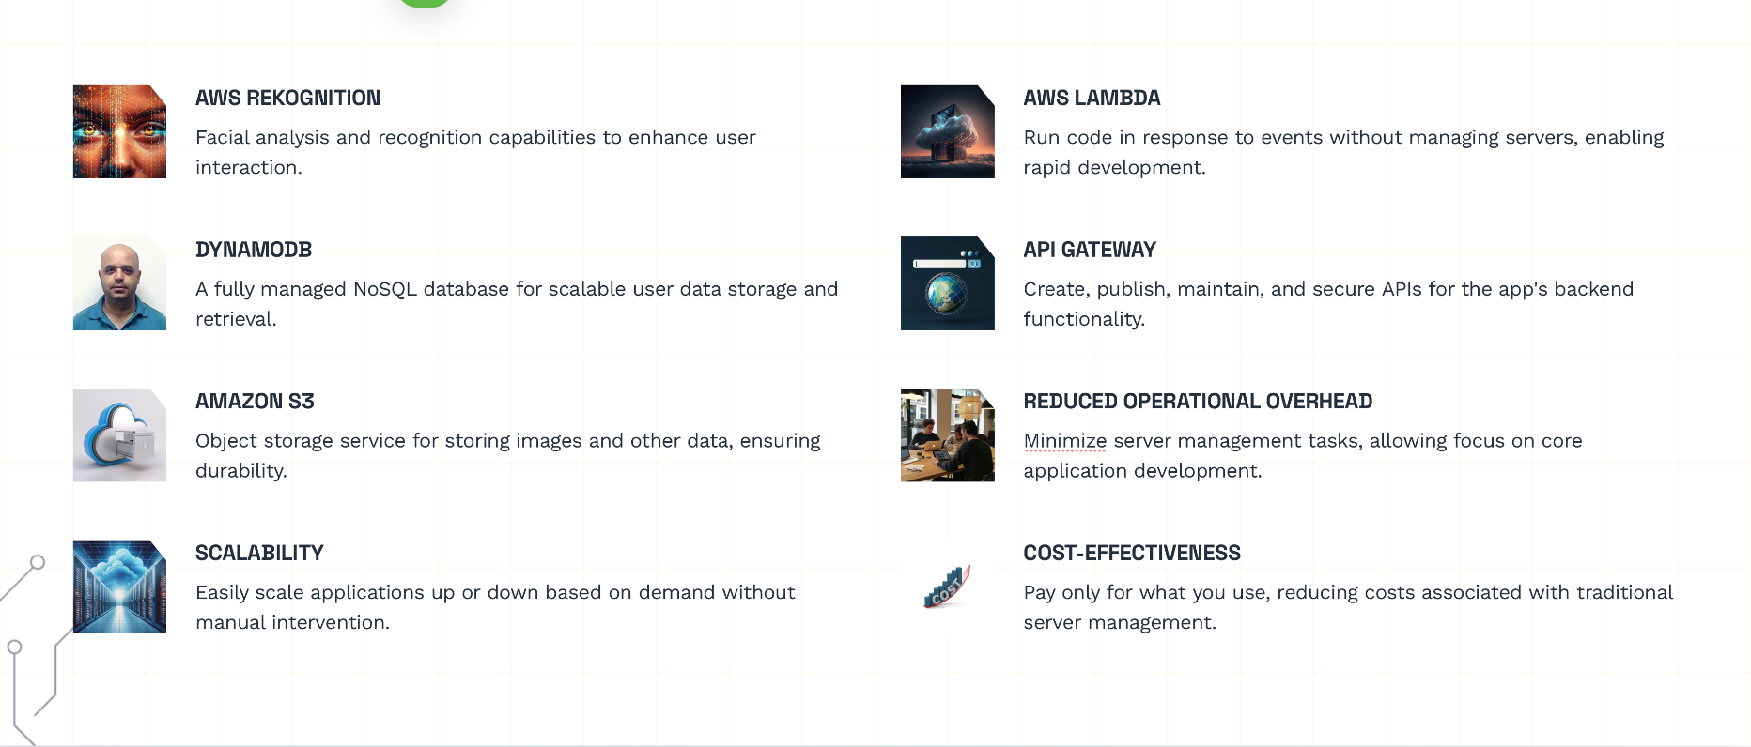
AWS SERVICES USED:

Slide 5
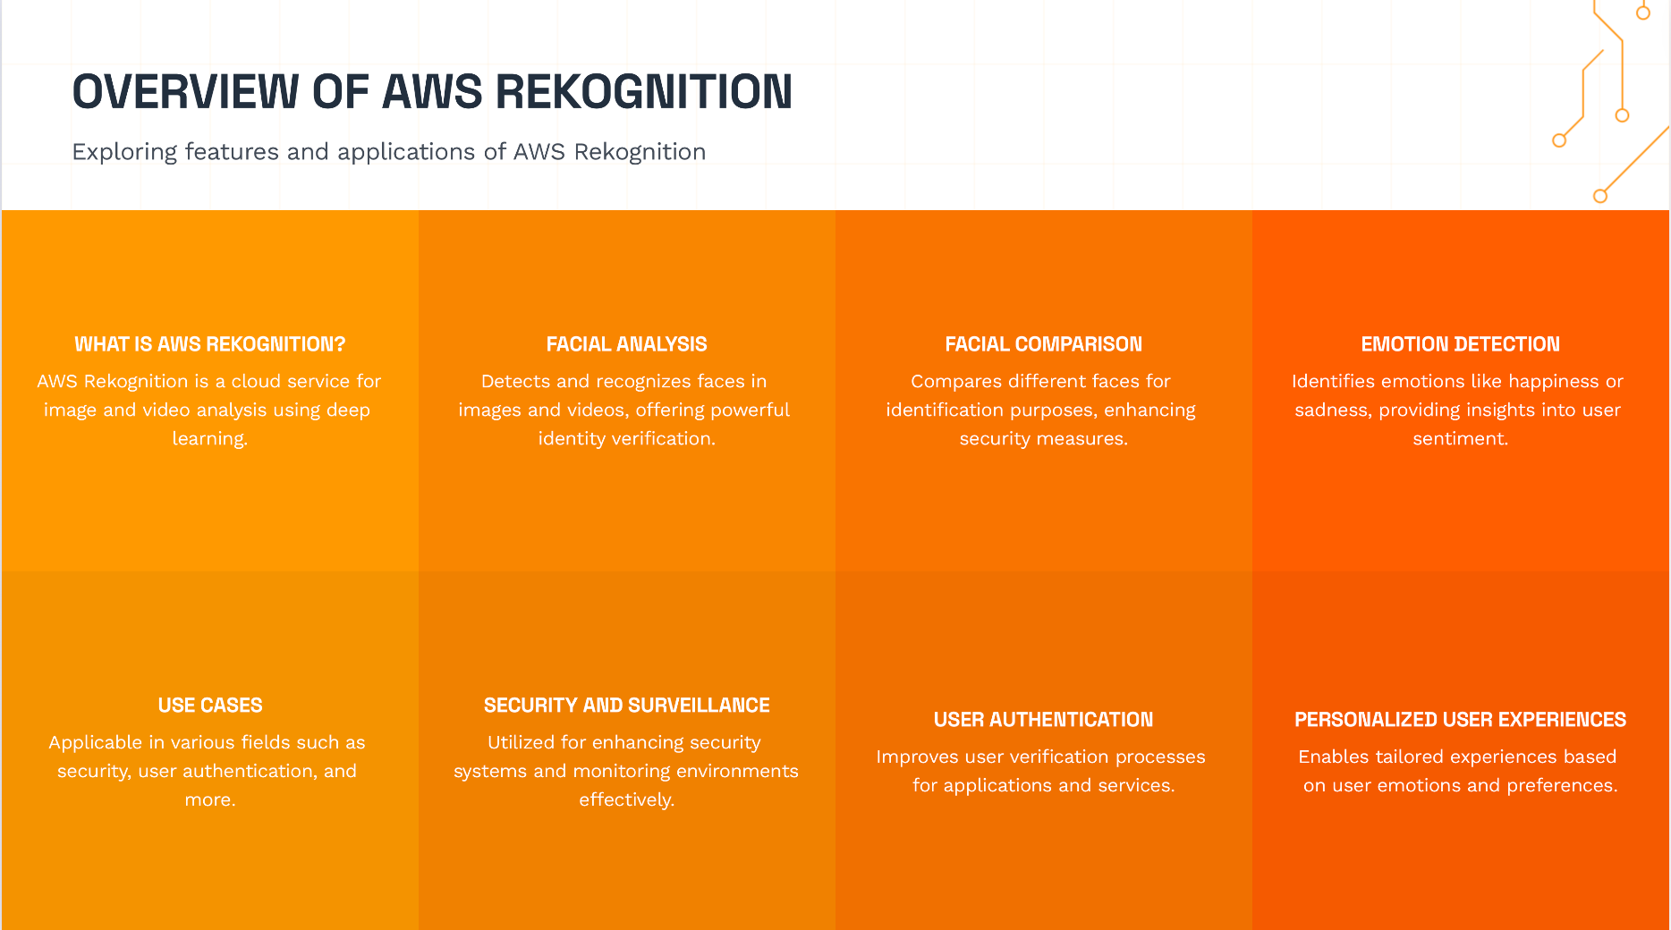

Slide 6
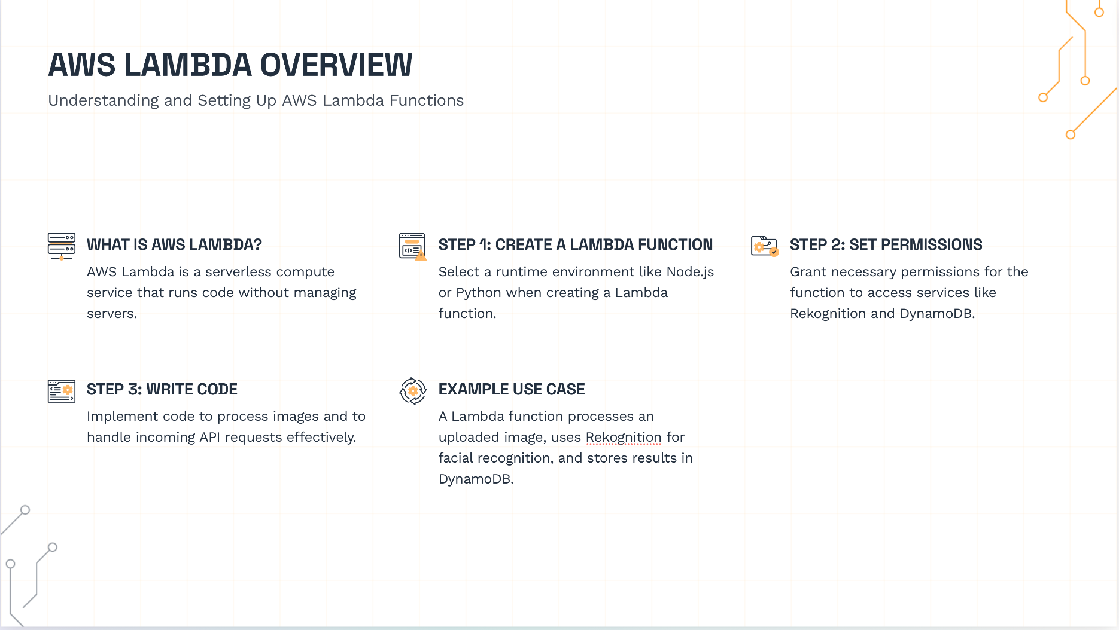

Slide 7
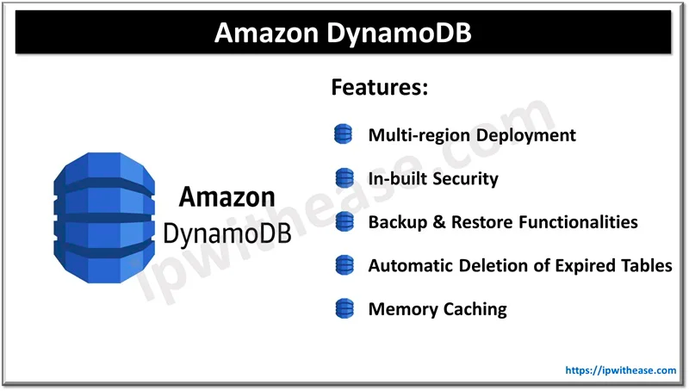


Slide 8
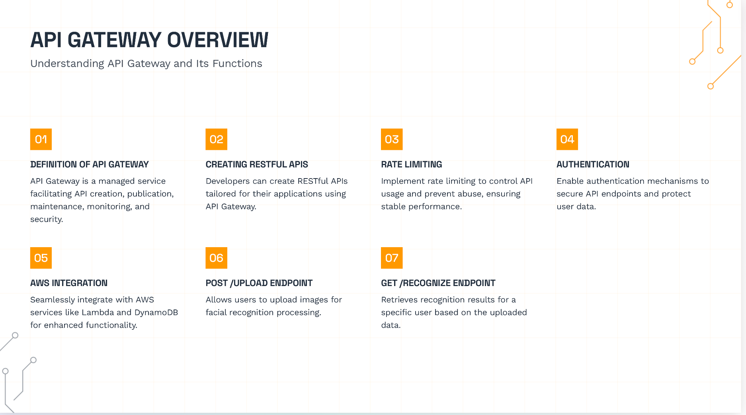

Slide 9
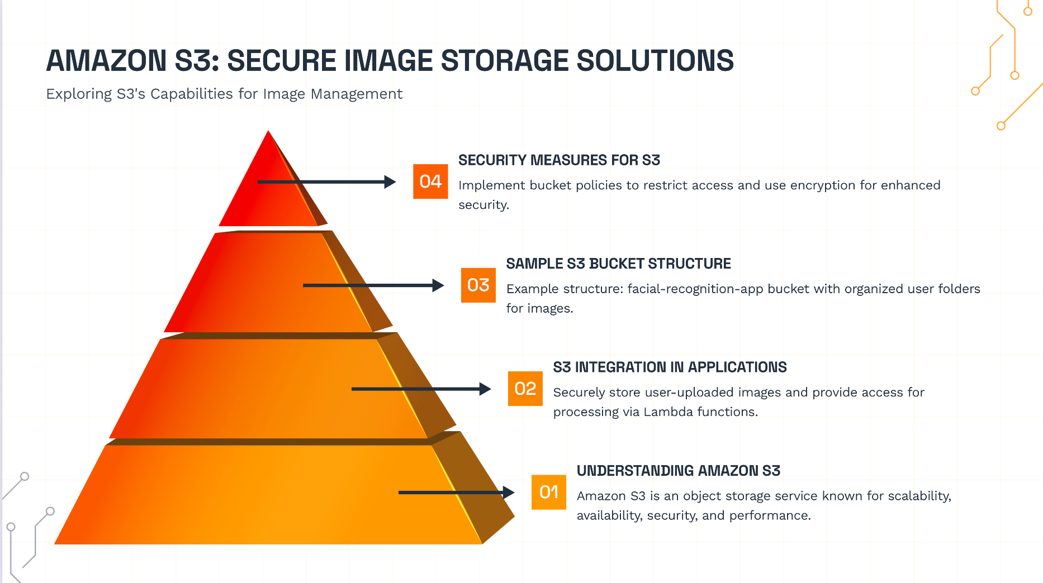

Slide 10
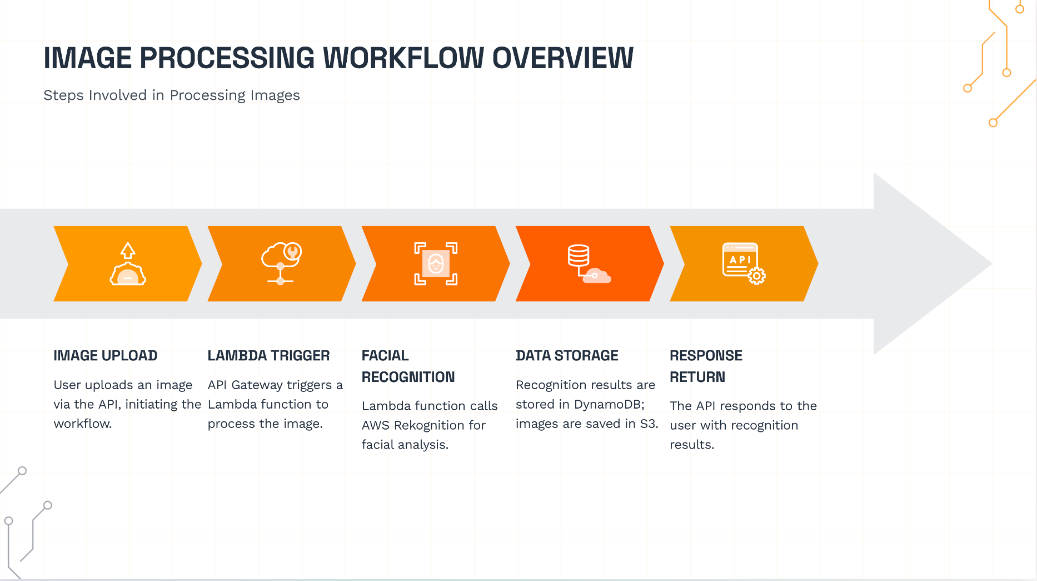

Slide 11


